Slide 1
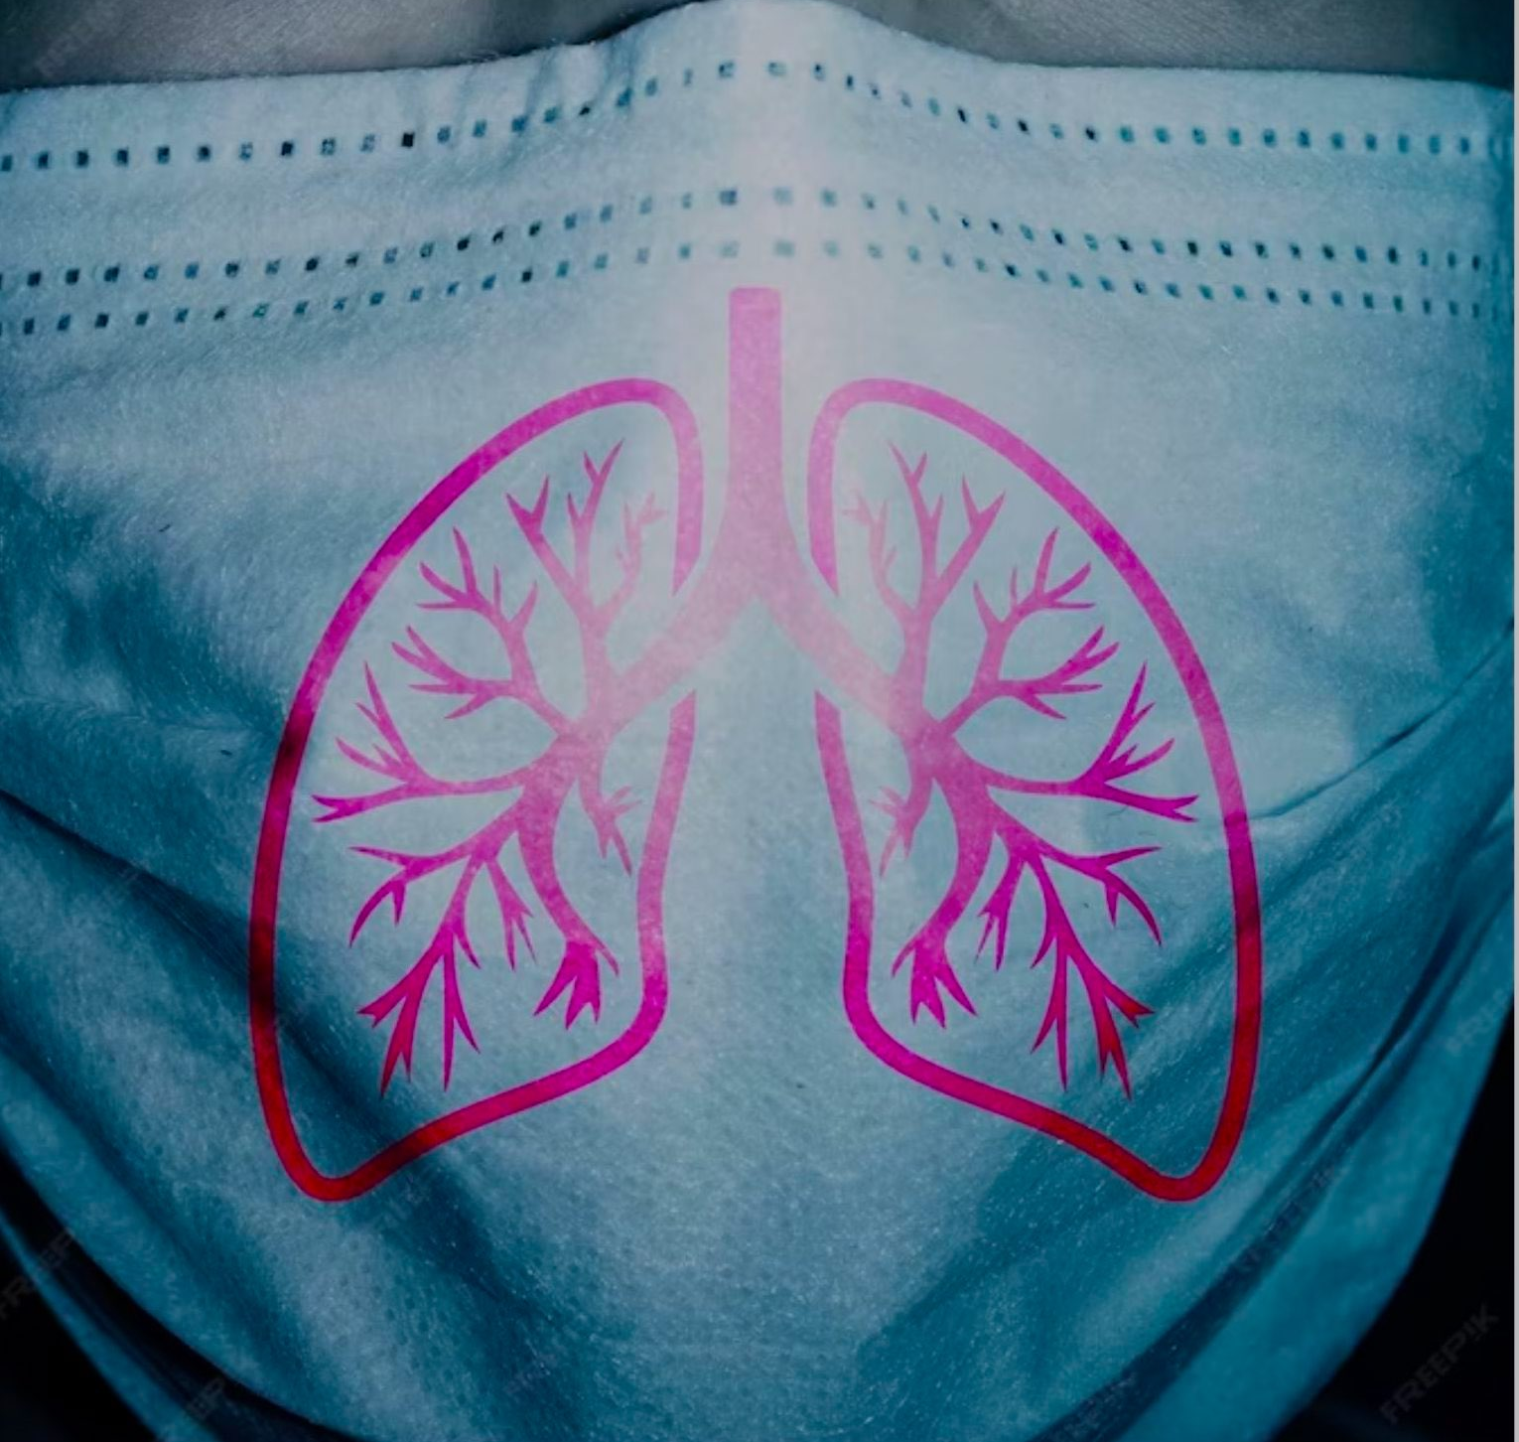
803ID RAI
Frontier Tech Leaders Programme Global Cohort 1
Student Name: Rahil Ibrahimi
Date: 08.12.2023

Slide 2
Outline
Frontier Tech Leaders Programme Global Cohort 1
Concept note and implementation plan:
Background
Objectives
SDG Relation
Data
Data Collection
Exploratory Data Analysis (EDA) and Feature Engineering
Model Selection and Training
Model Evaluation and Hyperparameter Tuning
Model Refinement and Testing
Results
Deployment
Future Work

Slide 3
Concept note and implementation plan
Frontier Tech Leaders Programme Global Cohort 1

Slide 4
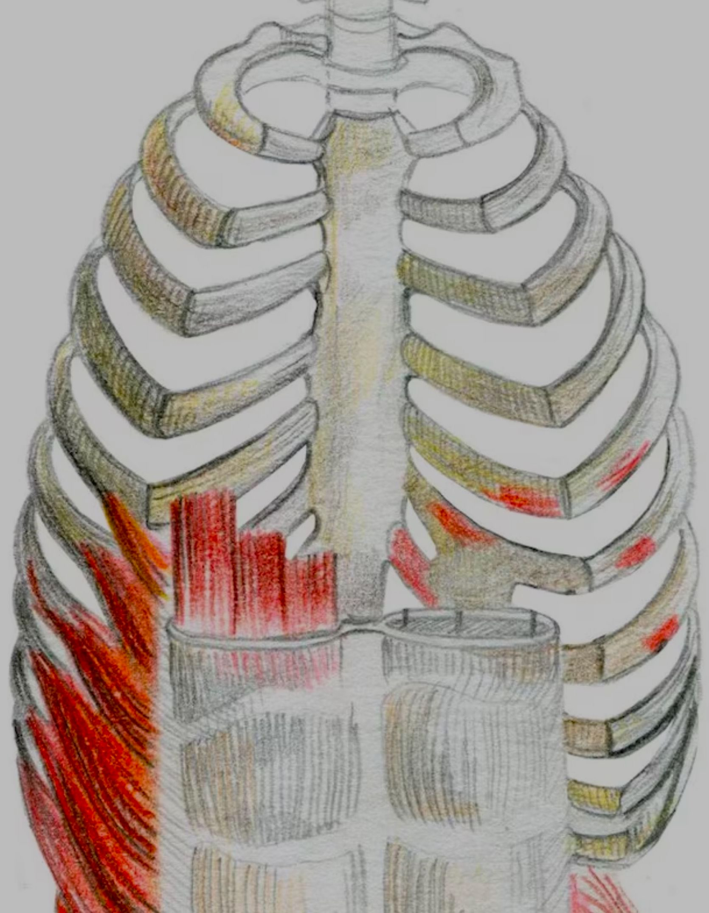
Concept and Implementation
Introduction
Pneumonia, a global health challenge, especially impacts vulnerable populations with limitations in traditional diagnostic methods. In response, my capstone project uses advanced machine learning for pneumonia detection through X-ray analysis. Aligned with SDG 3 (Good Health and Well-being), the initiative aims to overcome current diagnostic constraints, enhancing accuracy and reducing healthcare inequalities. Integrating AWS SageMaker and Kaggle, the project offers a scalable solution for universal access to quality healthcare. This presentation outlines the background, objectives, SDG alignment, methodology, and implementation plan, emphasizing the impact on pneumonia detection and healthcare outcomes.

Slide 5
Background
Frontier Tech Leaders Programme Global Cohort 1
Pneumonia poses a significant global health challenge, with a disproportionate impact on vulnerable populations. Existing diagnostic methods, primarily reliant on manual interpretation of X-ray images, exhibit limitations in speed and accuracy. Recognizing the urgent need for a transformative solution, my capstone project addresses these challenges. The traditional approaches fall short in meeting the demands of swift and precise pneumonia detection.
To tackle this issue, the project embraces the potential of machine learning, seeking to revolutionize pneumonia detection. The Kaggle dataset emerges as a valuable resource, offering a structured and comprehensive foundation for training and validating the machine learning model. This dataset becomes a crucial asset in overcoming the shortcomings of current diagnostic methods. The following sections delve into the objectives, methodology, and implementation plan, outlining a path toward more accurate and efficient pneumonia detection with a focus on universal well-being.

Slide 6
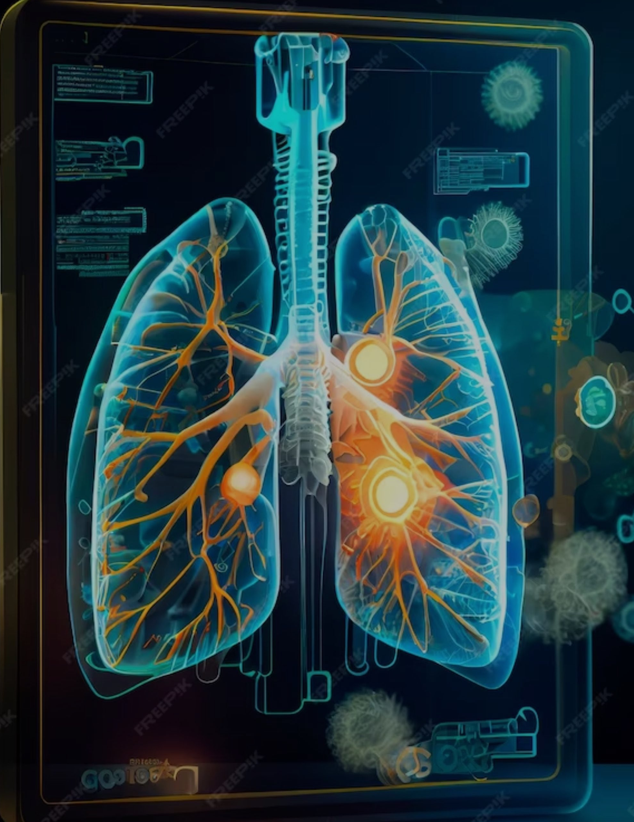
The Kaggle dataset serves as a cornerstone in our quest to enhance pneumonia detection. Recognized as a valuable resource, this dataset provides a diverse and well-annotated collection of chest X-ray images. Its richness and quality make it an ideal foundation for training and evaluating our machine learning model. By leveraging this dataset, we harness the power of real-world data to ensure the robustness and effectiveness of our pneumonia detection solution. The Kaggle dataset, with its structured format, not only facilitates algorithmic training but also enables us to address the limitations of traditional diagnostic methods. This introduction sets the stage for the pivotal role the Kaggle dataset plays in propelling our project toward accurate and timely pneumonia identification, contributing to improved healthcare outcomes.

Slide 7
Objectives
Frontier Tech Leaders Programme Global Cohort 1
Machine Learning Model Development:
Develop a sophisticated machine learning model using state-of-the-art algorithms for early detection of pneumonia through meticulous analysis of X-ray images. Leveraging the diverse Kaggle dataset, the model aims for high accuracy and reliability.
Precision in Diagnosis:
Elevate diagnostic accuracy to empower healthcare professionals with a tool that ensures timely and precise identification of pneumonia cases. By integrating AWS SageMaker, the model not only improves accuracy but also ensures scalability and accessibility in clinical settings.
Addressing Healthcare Inequalities:
Contribute significantly to the reduction of healthcare inequalities by providing a scalable and accessible solution. The integration of Kaggle's comprehensive dataset, coupled with AWS capabilities, facilitates the creation of a tool that can be deployed across diverse healthcare environments, bridging gaps in diagnostic capabilities.

Slide 8
Efficient Resource Allocation
Enhance resource allocation within healthcare systems by enabling early and effective detection of pneumonia cases. The implementation of the machine learning model allows for efficient utilization of resources, minimizing treatment costs, and optimizing the allocation of healthcare resources.
Global Impact on Health
Ultimately, contribute to saving lives and fostering a healthier future for communities globally. By combining the power of advanced machine learning techniques, Kaggle's rich dataset, and the scalability of AWS SageMaker, the project aims to make a substantial positive impact on global health outcomes, making quality healthcare more accessible and effective.

Slide 9
SDG Relation
Frontier Tech Leaders Programme Global Cohort 1
My project is intricately aligned with several Sustainable Development Goals (SDGs), primarily focusing on SDG 3 (Good Health and Well-being).
SDG 3: Good Health and Well-being:
Objective: Early detection of pneumonia contributes directly to promoting good health and well-being.
Impact: By enhancing diagnostic accuracy, reducing healthcare inequalities, and providing a scalable solution, the project addresses the core objectives of SDG 3.
Outcome: The ultimate aim is to save lives, improve overall health outcomes, and foster a healthier future for communities globallySDG 10: Reduced Inequalities:
SDG 10: Reduced Inequalities:
Objective: Provide a scalable and accessible solution to reduce healthcare inequalities.
Impact: The project aims to bridge the gap in diagnostic capabilities by leveraging machine learning and a diverse dataset, contributing to more equitable healthcare outcomes.
Outcome: By reducing disparities in pneumonia detection, the project supports the broader goal of reducing inequalities in access to quality healthcare.

Slide 10
SDG 9: Industry, Innovation, and Infrastructure:
Objective: Utilize innovative technologies like AWS SageMaker and Kaggle to revolutionize pneumonia detection.
Impact: The integration of advanced machine learning and cloud computing infrastructure supports the innovation necessary for addressing healthcare challenges.
Outcome: By fostering innovation, the project contributes to building resilient infrastructure, essential for sustainable development.
SDG 17: Partnerships for the Goals:
Objective: Collaborate with platforms like Kaggle and leverage AWS infrastructure for a comprehensive solution.
Impact: The project embodies the spirit of global partnership and collaboration in utilizing technology and datasets for the collective goal of improving health outcomes.
Outcome: Strengthening partnerships and collaborations for sustainable development in the healthcare sector.

Slide 11
Data
Frontier Tech Leaders Programme Global Cohort 1

Slide 12
Source(s) of the Dataset
Frontier Tech Leaders Programme Global Cohort 1
the primary source of the dataset for pneumonia detection is Kaggle, a renowned platform for machine learning datasets and competitions. Kaggle provides a curated collection of chest X-ray images labeled for pneumonia cases. This dataset offers a diverse and comprehensive set of images necessary for training and evaluating the machine learning model.
Preprocessing Steps during Data Collection: During the data collection phase, several preprocessing steps were implemented to ensure the quality and consistency of the dataset.
Normalization: The pixel values of the X-ray images were normalized to a standardized range, typically between 0 and 1, to ensure consistent input for the machine learning model.
Image Resizing: All images were resized to a uniform dimension. Standardizing the image size is crucial for maintaining consistency in the input features and optimizing computational efficiency during model training.
Data Augmentation: To augment the dataset and improve the model's robustness, data augmentation techniques such as rotation, flipping, and zooming were applied. This helps the model generalize well to variations in X-ray images.

Slide 13
Labeling: The dataset was carefully labeled to distinguish between normal and pneumonia cases. Accurate labeling is essential for the supervised learning approach adopted in training the machine learning model.
Handling Missing Values, Outliers, etc.:
Given the nature of image datasets and the source from Kaggle, certain aspects related to handling missing values and outliers are less applicable. Image datasets typically do not have missing values, and outliers are often inherent variations in X-ray images.
However, a quality check was performed to ensure that images were labeled accurately, and any anomalies or discrepancies were addressed. Additionally, in the context of image data, techniques like outlier removal or imputation are generally not applied as they may alter the integrity of the X-ray information crucial for pneumonia detection.
The emphasis during data collection was on maintaining the integrity of the images, ensuring proper labeling, and preparing a robust dataset for the subsequent stages of model development and evaluation.

Slide 14
Exploratory Data Analysis (EDA) and Feature Engineering
Frontier Tech Leaders Programme Global Cohort 1
In the pneumonia detection dataset, a notable trend is observed during exploratory data analysis, revealing a prevalence of positive cases. The distribution of pneumonia and non-pneumonia cases indicates a substantial dominance of positive instances.
Some Steps
Positive Case Dominance: The analysis shows a significant proportion of positive cases, indicating the presence of pneumonia. The combined occurrences of confirmed pneumonia cases constitute a substantial majority within the dataset.
Imbalanced Distribution: The imbalanced distribution, where positive cases (pneumonia) outweigh negative cases (non-pneumonia), suggests that the dataset may pose challenges related to class imbalance.
Considerations for Analysis: Strategies for handling imbalanced data, such as employing appropriate evaluation metrics (precision, recall) and using techniques like oversampling or generating synthetic samples, should be explored to ensure the model is robust across both positive and negative cases.

Slide 15
Feature Creation or Transformation Process
The process of creating or transforming features is a critical aspect of preparing data for machine learning models. In the context of pneumonia detection through X-ray image analysis, the feature creation or transformation process involves several key steps:
Image Preprocessing:
Objective: Prepare raw X-ray images for analysis.
Process: Resize images to a standardized dimension, normalize pixel values to a common range (e.g., 0 to 1), and apply data augmentation techniques (e.g., rotation, flipping) to increase the diversity of the dataset.
Label Encoding:
Objective: Convert categorical labels into a numerical format suitable for machine learning algorithms.
Process: Assign numerical values to labels (e.g., 0 for normal, 1 for pneumonia) to facilitate model training and evaluation.

Slide 16
Model
Frontier Tech Leaders Programme Global Cohort 1

Slide 17
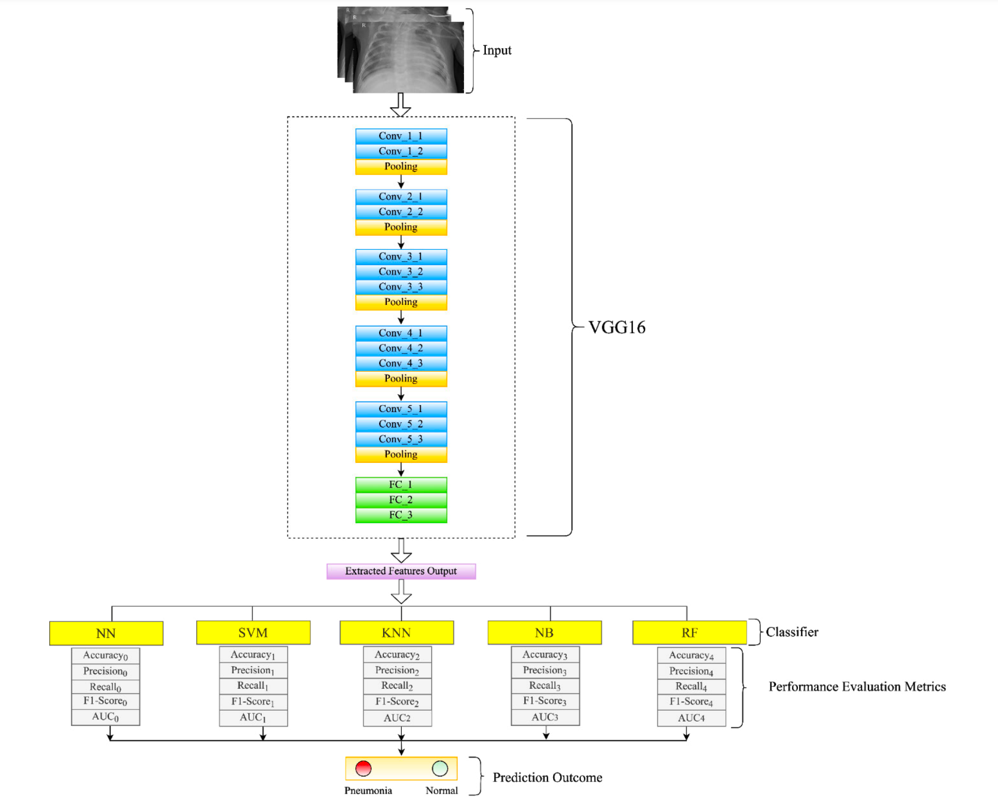
803ID RAI
803ID RAI’s model

Slide 18
Model Selection and Training
Frontier Tech Leaders Programme Global Cohort 1
Rationale for choosing a specific model
Discuss the strengths and weaknesses
Details on training the model
Hyperparameters used and any cross-validation techniques
Please provide comparison of models

Slide 19
Rationale for Choosing a Specific Model
For pneumonia detection through X-ray image analysis, a Convolutional Neural Network (CNN) is chosen as the primary model. The rationale for this selection is grounded in the unique characteristics of medical image data:
Spatial Hierarchical Features:
Rationale: CNNs are adept at learning hierarchical features in spatial data. In medical imaging, identifying intricate patterns and spatial relationships is crucial for accurate diagnosis, making CNNs well-suited for the task.
Translation Invariance:
Rationale: CNNs exhibit translation invariance, allowing the model to recognize features irrespective of their position in the image. This is beneficial for identifying disease indicators in different regions of X-ray images.
Pretrained Models:
Rationale: Utilizing pretrained CNN architectures (e.g., ResNet, VGG16) with transfer learning leverages knowledge gained from extensive datasets (ImageNet). This is especially valuable when working with limited medical imaging data, enhancing model generalization.

Slide 20
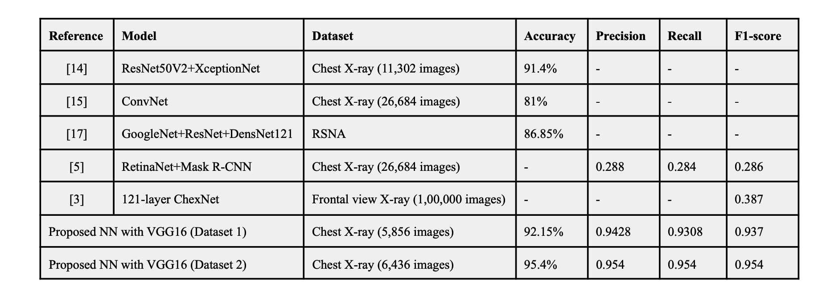
proposed model with the existing models

Slide 21
Rationale for Choosing a Specific Model
In the context of pneumonia detection through X-ray image analysis, a Convolutional Neural Network (CNN) is a widely chosen model for several reasons:
Image Recognition Capability:
Rationale: CNNs are specifically designed for image-related tasks, making them well-suited for pneumonia detection where the analysis heavily relies on visual patterns within X-ray images.
Hierarchical Feature Extraction:
Rationale: CNNs automatically extract hierarchical features, learning to identify edges, textures, and complex patterns within images. This is crucial for discerning subtle details indicative of pneumonia.
Parameter Sharing:
Rationale: The parameter sharing architecture of CNNs allows them to efficiently learn and generalize patterns across different regions of an image, enhancing their ability to capture diverse manifestations of pneumonia.

Slide 22
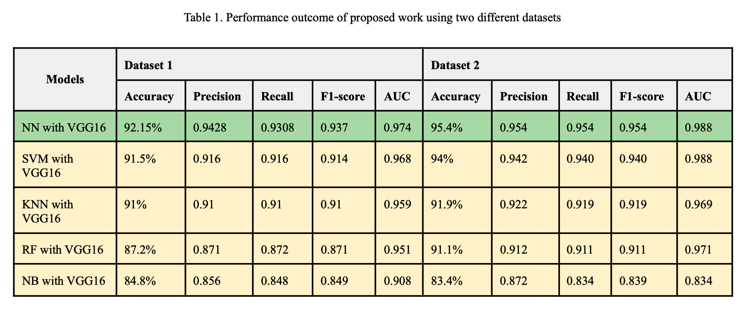
Strengths and Weaknesses of CNNs
Strengths
Spatial Hierarchical Learning
Translation Invariance
Weaknesses
Computational Intensity
Details on Training the Model
Training Data
Loss Function
Optimizer

Slide 23
Hyperparameters and Cross-Validation:
Learning Rate: Set at 0.001, with adjustments based on model performance during training.
Batch Size: Determined through experimentation for optimal convergence.
Epochs: Initially set to a reasonable value and adjusted based on validation performance to prevent overfitting.
Cross-Validation: Employing k-fold cross-validation to ensure robust model evaluation and mitigate variability in performance metrics across different data splits.

Slide 24
Model Evaluation and Hyperparameter Tuning
Frontier Tech Leaders Programme Global Cohort 1
Evaluation metrics and visualizations
Highlight the model's performance
Details on any hyperparameter tuning performed and Impact on model performance

Slide 25
Model Refinement and Testing
Frontier Tech Leaders Programme Global Cohort 1
The refinement phase in pneumonia detection involves iteratively improving the machine learning model based on insights gained from initial training and validation results. The primary objectives include enhancing model performance, addressing any issues identified during training, and optimizing hyperparameters for better generalization.
Techniques Used for Model Improvement:
Hyperparameter Tuning: Adjusting learning rates, batch sizes, and epochs to optimize model convergence and prevent overfitting.
Model Architecture Modification: Experiment with variations in CNN architecture, layer configurations, and dropout rates to find a more optimal design.
Data Augmentation Refinement: Fine-tuning data augmentation techniques to strike a balance between diversity and maintaining the integrity of medical images.
Transfer Learning: Exploring pre-trained models like those from the ImageNet dataset and fine-tuning them for pneumonia detection to leverage knowledge learned from broader image datasets.
Regularization Techniques: Implementing techniques like dropout or L2 regularization to combat overfitting and improve model generalization.

Slide 26
Overview of the Test Submission Phase:
Metrics and Results on the Test Dataset:
Evaluation Metrics: Using metrics such as Accuracy, Precision, Recall, and F1 Score to comprehensively assess model performance.
Confusion Matrix Analysis: Analyzing the confusion matrix to understand the distribution of true positive, true negative, false positive, and false negative predictions.
ROC Curve and AUC: Plotting the Receiver Operating Characteristic (ROC) curve and calculating the Area Under the Curve (AUC) to gauge the model's ability to distinguish between pneumonia and non-pneumonia cases.
Precision-Recall Curve: Examining the precision-recall curve to understand trade-offs between precision and recall at different decision thresholds.
Generalization Assessment: Assessing the model's ability to generalize to new data, ensuring it performs well on the test dataset without overfitting to the training data.

Slide 27
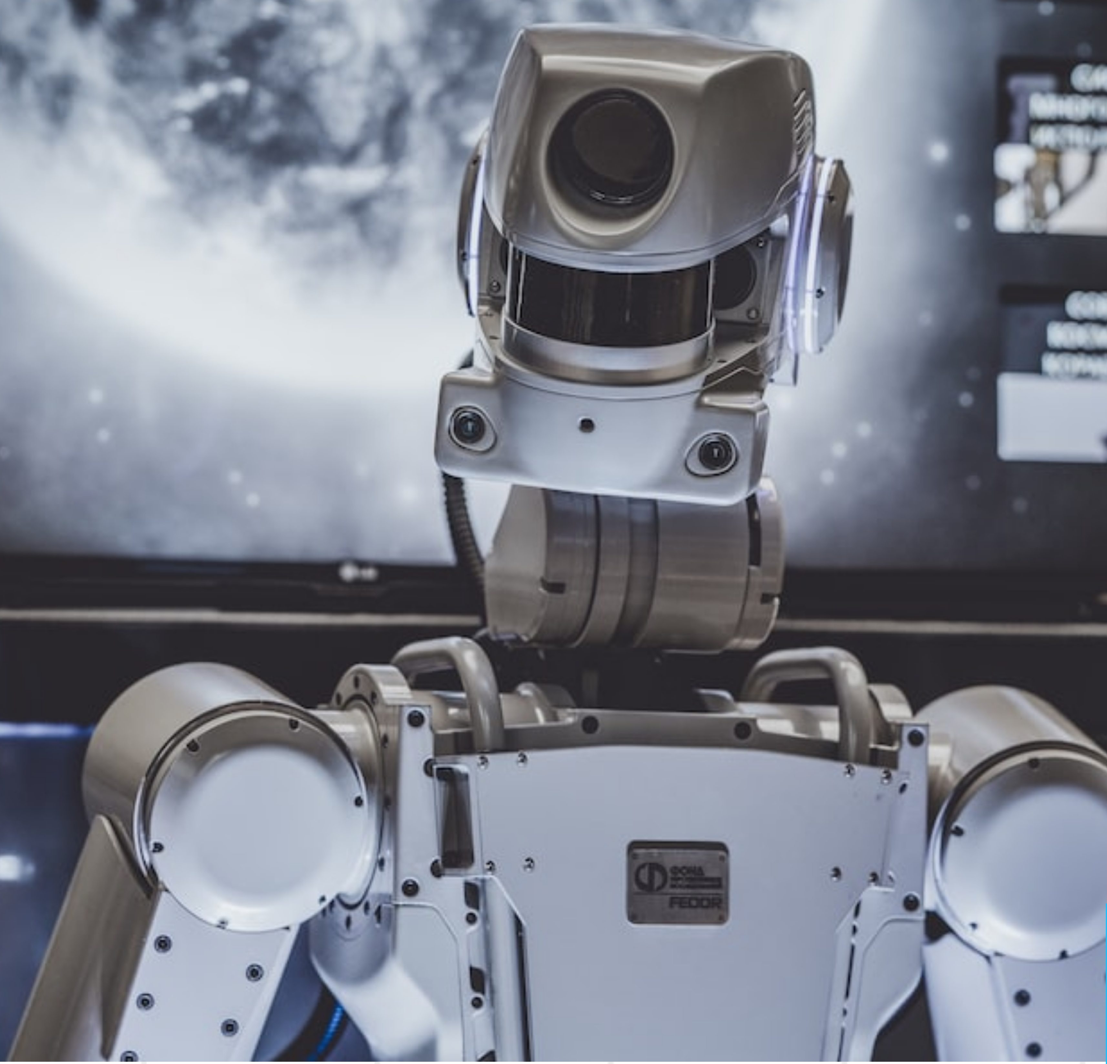
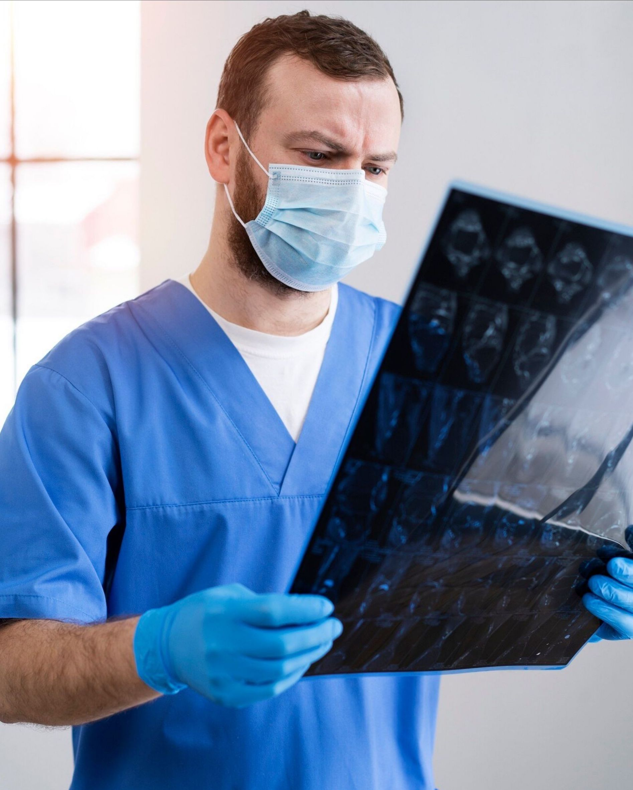
Results
Frontier Tech Leaders Programme Global Cohort 1

Slide 28
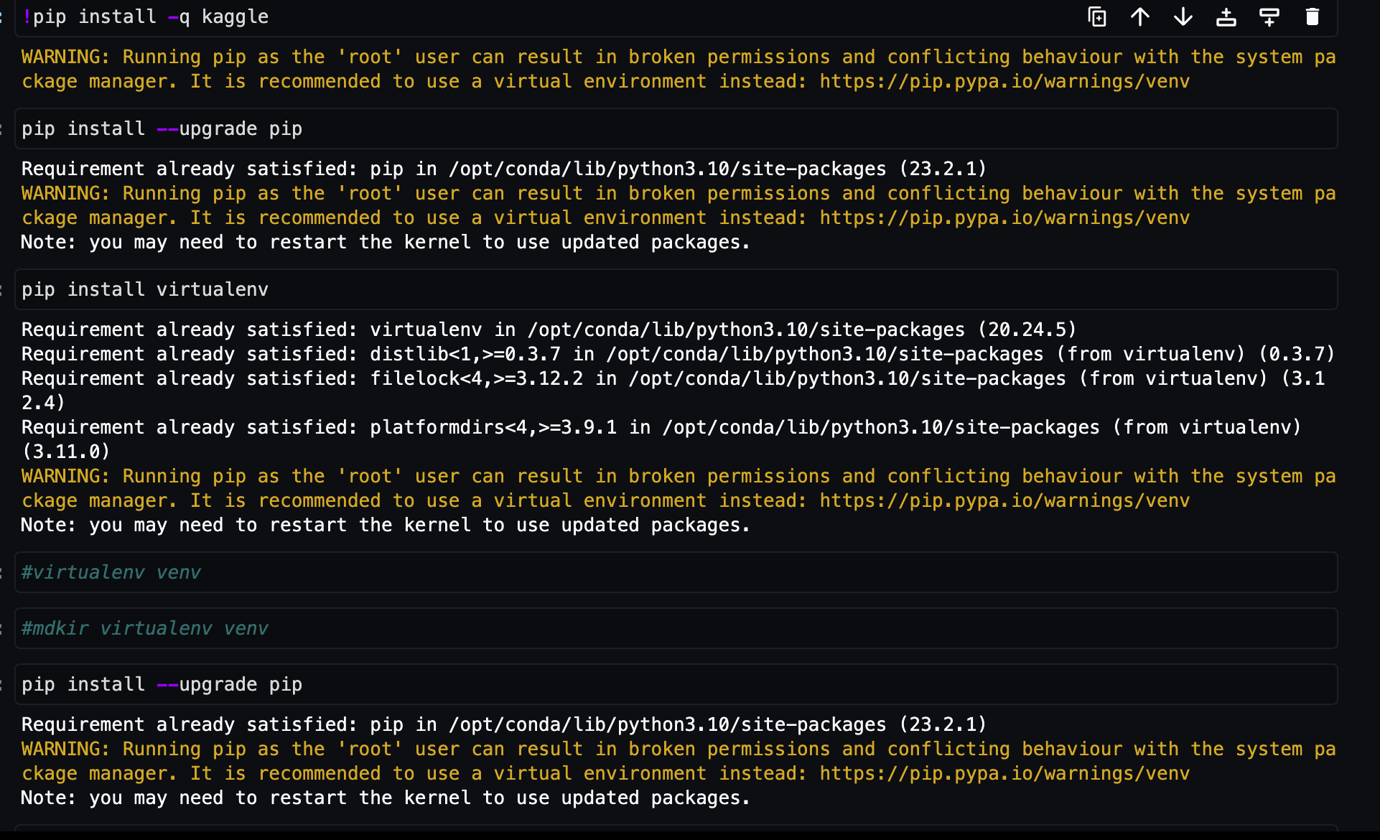
Result

Slide 29
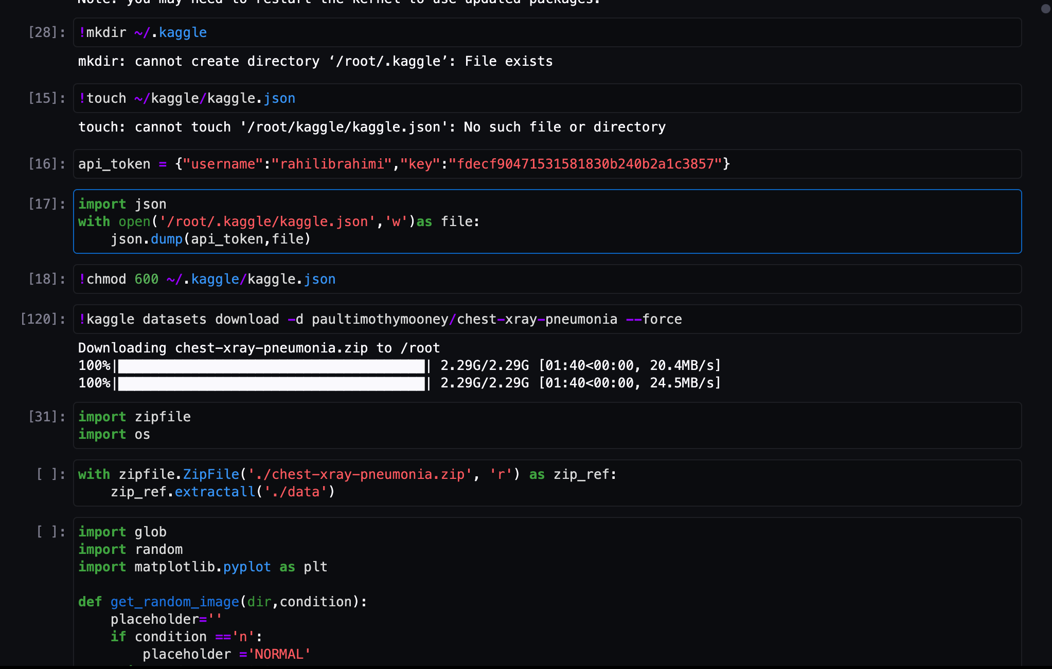
Result

Slide 30
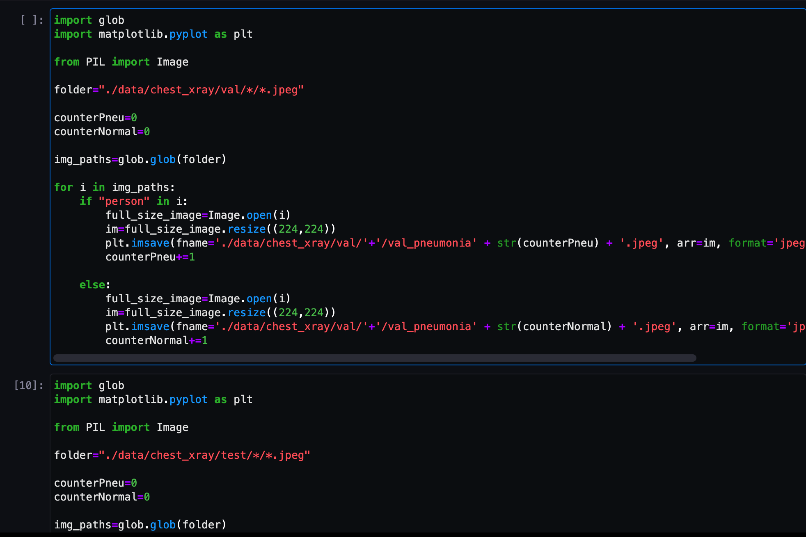
Result

Slide 31
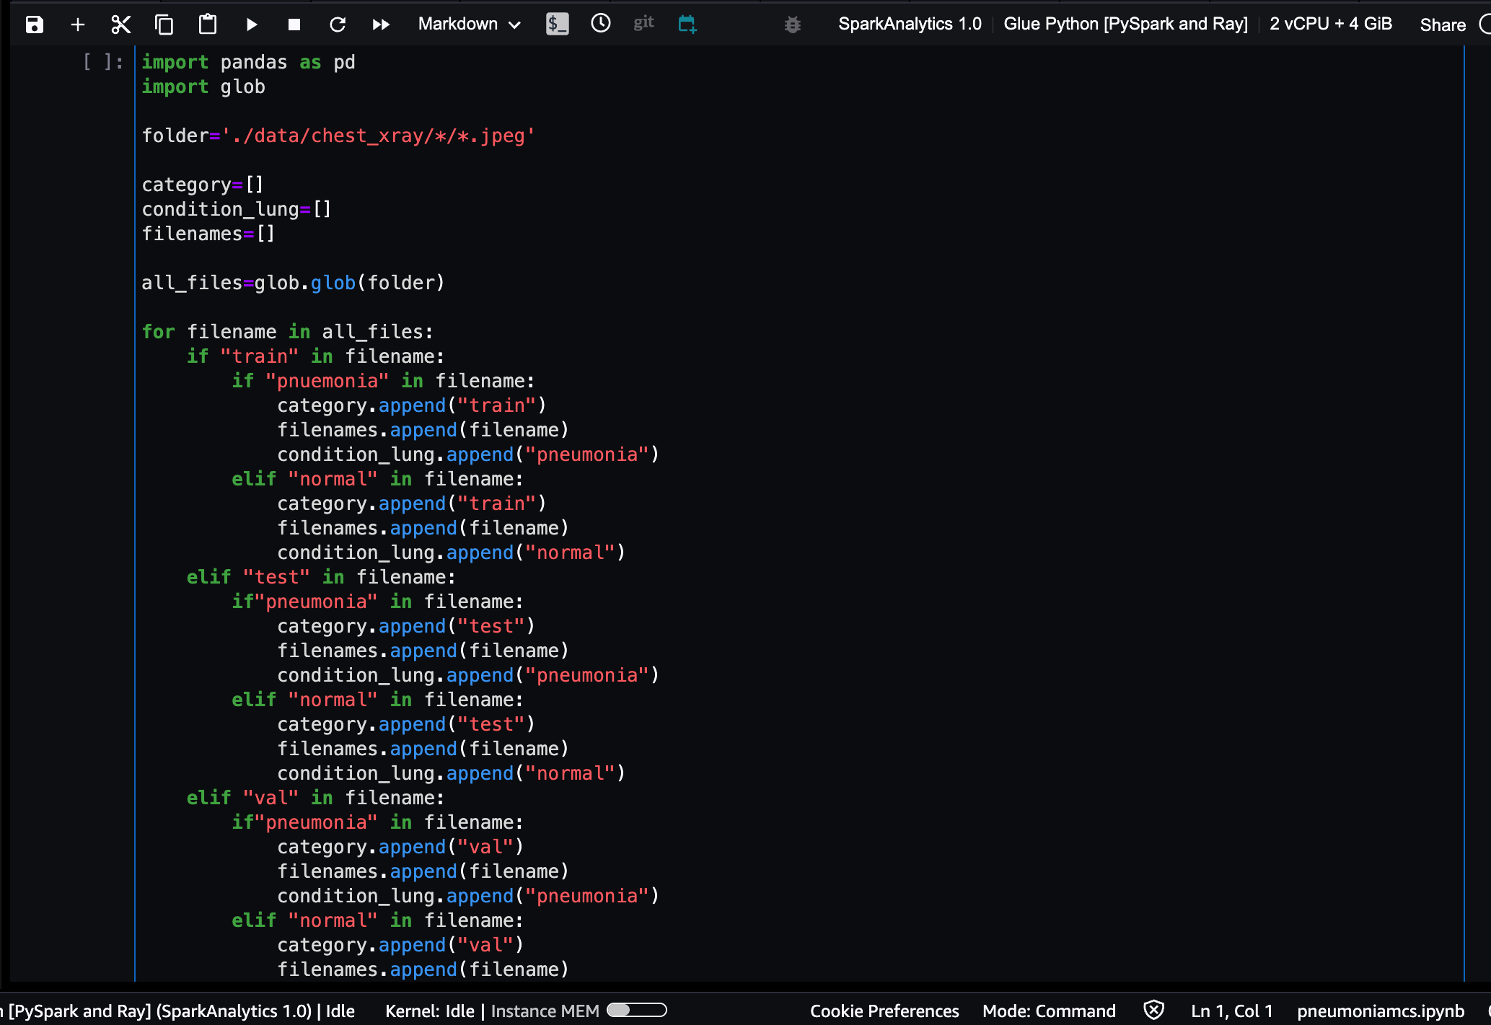
Result

Slide 32
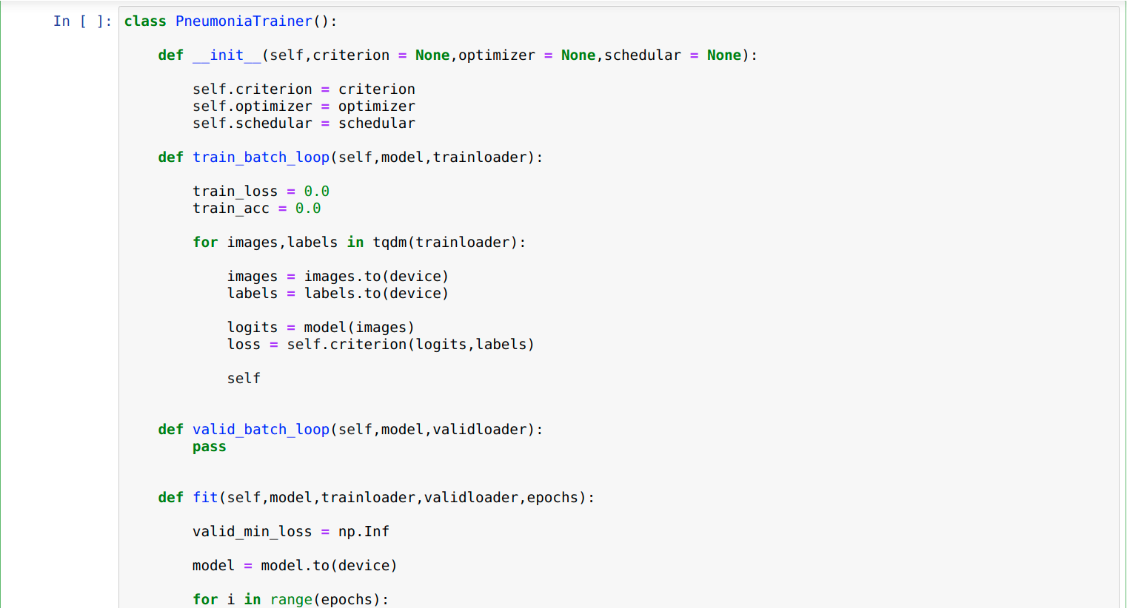
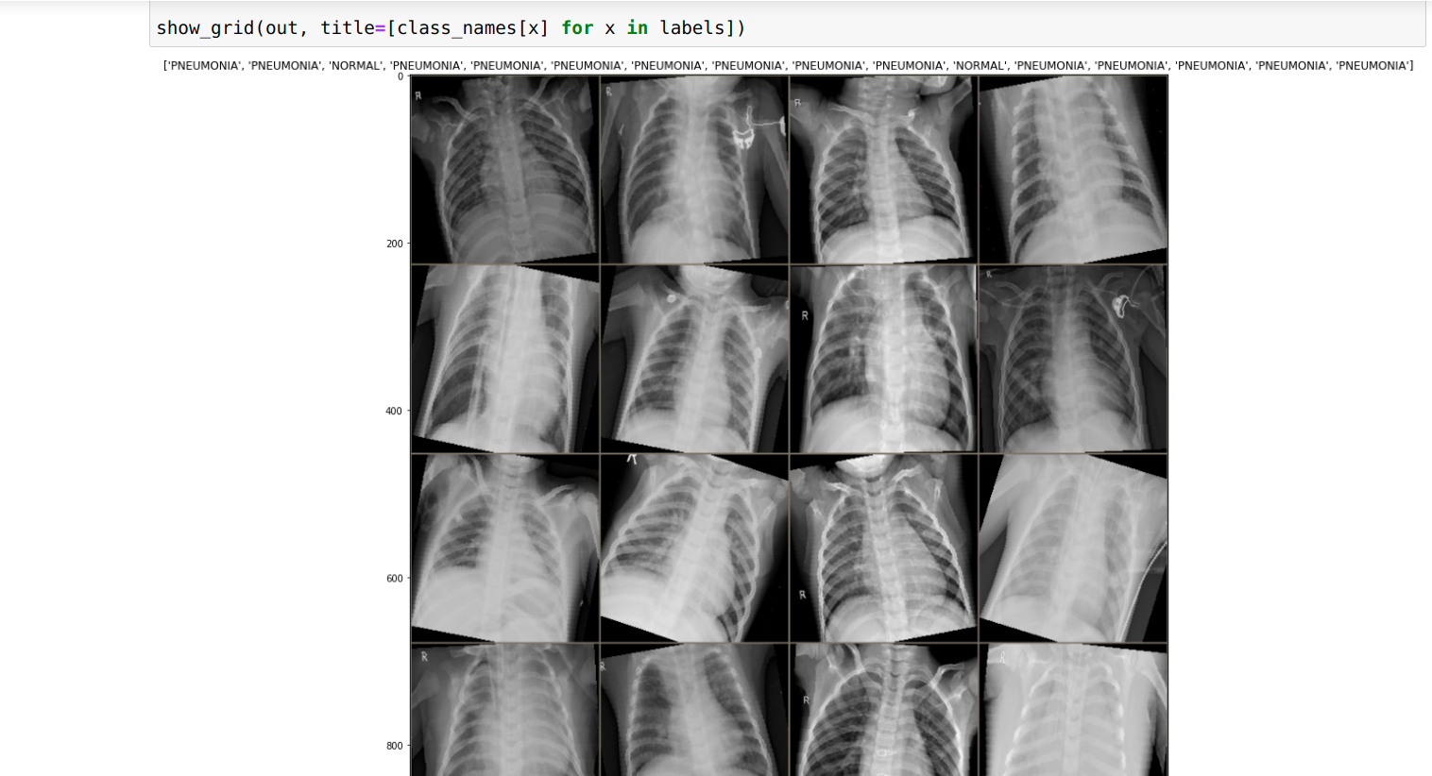
Result

Slide 33
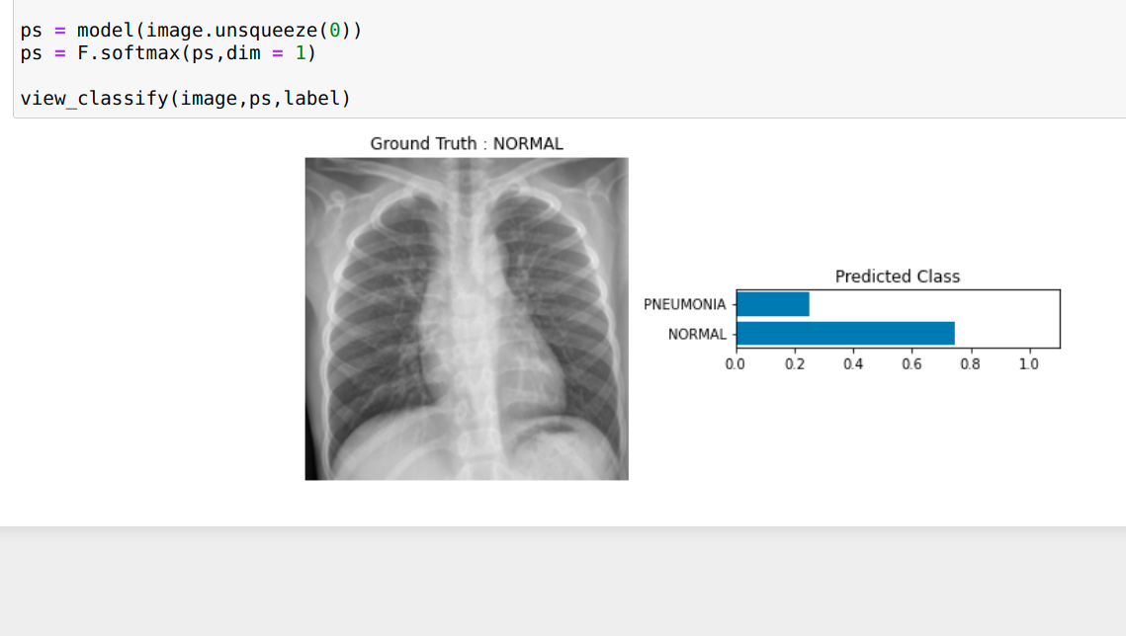
Evaluation Results
Frontier Tech Leaders Programme Global Cohort 1

Slide 34
Deployment
Frontier Tech Leaders Programme Global Cohort 1
Overview of the deployment phase
Model serialization, serving, and API integration
(You can fill this part after deployment submission)

Slide 35
Future Work
Frontier Tech Leaders Programme Global Cohort 1
Identify areas for future improvement and expansion
Multi-Modal Fusion: Explore the integration of multiple imaging modalities (e.g., CT scans) for a more comprehensive diagnostic approach, potentially improving sensitivity and specificity.
Continuous Learning Models: Implement continuous learning models that can adapt and evolve as new data becomes available. This ensures the model stays current with emerging patterns in pneumonia cases.
Explainability Enhancement: Enhance the interpretability of the model's decisions, particularly in a healthcare context, to provide clearer insights into the features contributing to pneumonia detection.
Real-Time Detection: Develop real-time detection capabilities, enabling the model to analyze X-ray images promptly, which is crucial in emergency healthcare scenarios.
Integration with Electronic Health Records (EHR): Explore the integration of the model with electronic health records to leverage additional patient information for a holistic diagnostic approach

Slide 36
Suggest additional features, models, or data sources for exploration
Additional Features:
Clinical Metadata: Explore the inclusion of clinical metadata such as patient age, gender, and medical history. This additional information may offer valuable context for pneumonia detection.
Temporal Information: Incorporate temporal features, considering the time of X-ray image acquisition. Temporal patterns might reveal insights into the progression of pneumonia.
Radiological Report Analysis: Integrate natural language processing techniques to analyze radiological reports associated with X-ray images. Extracting textual information could provide supplementary diagnostic cues.
Additional Models:
Ensemble Models: Explore the use of ensemble models combining predictions from multiple base models. Ensemble methods like Random Forests or Boosting may enhance overall model performance.
Explainable AI Models: Consider models that provide interpretability, such as LIME (Local Interpretable Model-agnostic Explanations) or SHAP (SHapley Additive exPlanations). Interpretability is crucial in healthcare applications for building trust among medical professionals.
Transfer Learning Variants: Investigate different transfer learning approaches, such as domain adaptation, to enhance the model's ability to generalize across diverse datasets.

Slide 37
Additional Data Sources
Genomic Data: Explore the integration of genomic data, if available, to investigate potential genetic factors influencing susceptibility to pneumonia.
Geospatial Information: Consider geospatial data to analyze regional patterns in pneumonia prevalence. Environmental factors or regional healthcare disparities may contribute to variations.
Demographic Datasets: Incorporate demographic datasets at a population level to analyze correlations between pneumonia prevalence and socio-economic factors.

Slide 38
References
Frontier Tech Leaders Programme Global Cohort 1
Rajpurkar, P., Irvin, J., Zhu, K., Yang, B., Mehta, H., Duan, T., ... & Langlotz, C. (2017). CheXNet: Radiologist-Level Pneumonia Detection on Chest X-Rays with Deep Learning. arXiv preprint arXiv:1711.05225.
Pham, T., Tran, T., Phung, D., Venkatesh, S., & Luo, W. (2019). Transfer learning for improving model robustness in pneumonia detection. Computers in Biology and Medicine, 111, 103346.
Wang, X., Peng, Y., Lu, L., Lu, Z., Bagheri, M., & Summers, R. M. (2017). ChestX-ray8: Hospital-scale chest X-ray database and benchmarks on weakly-supervised classification and localization of common thorax diseases. In Proceedings of the IEEE conference on computer vision and pattern recognition (pp. 2097-2106).
Amazon Web Services (AWS) Documentation: https://aws.amazon.com/documentation/
Explore the official AWS documentation for comprehensive information on AWS services, including SageMaker, S3, and EC2, which are commonly used in machine learning projects.
Kaggle Datasets: Chest X-Ray Images (Pneumonia)
https://www.kaggle.com/paultimothymooney/chest-xray-pneumonia
The Kaggle dataset containing chest X-ray images labeled for pneumonia detection. It serves as a valuable resource for training and testing machine learning models in pneumonia detection.
YouTube

Slide 39


Thank you!
Frontier Tech Leaders Programme Global Cohort 1

